Slide 1

Cognitive Computing
Dr. Piyush Joshi
Assistant Professor
IIIT Sri City

Slide 2
Our unique brain capabilities: Motion
Precision throwing: no other animal can do that even they have visual motion detection capabilities.
Avoid/catch animal by looking their motion
Facial expressions are incredibly subtle and we can detect fleeting expressions.
Direction of motion

Slide 3
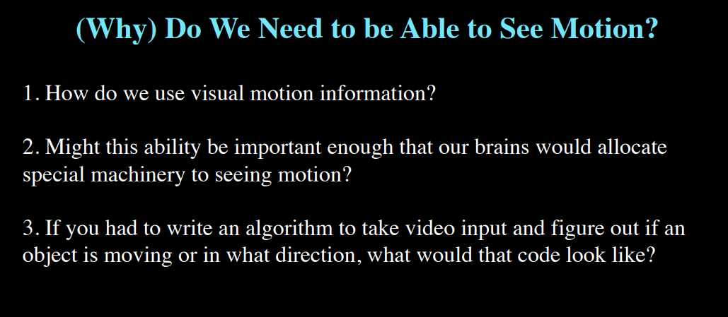

Slide 4
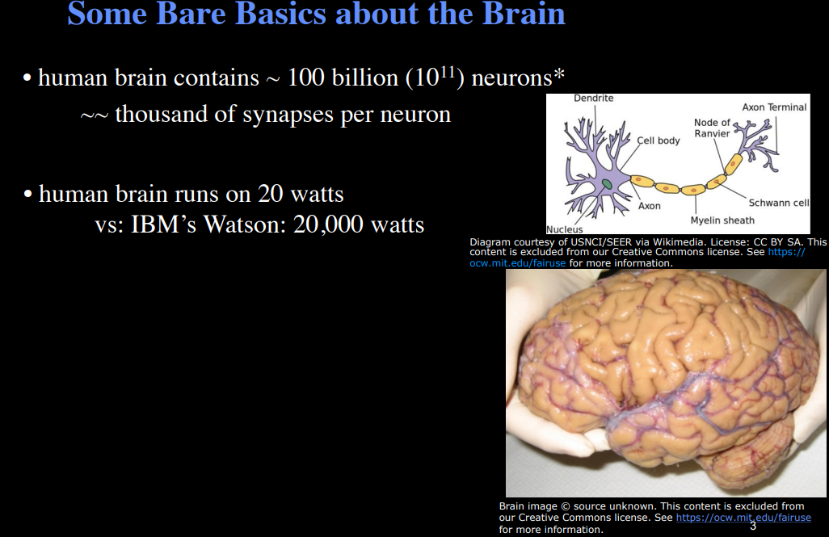
Brain is incredibly energetically efficiently

Slide 6
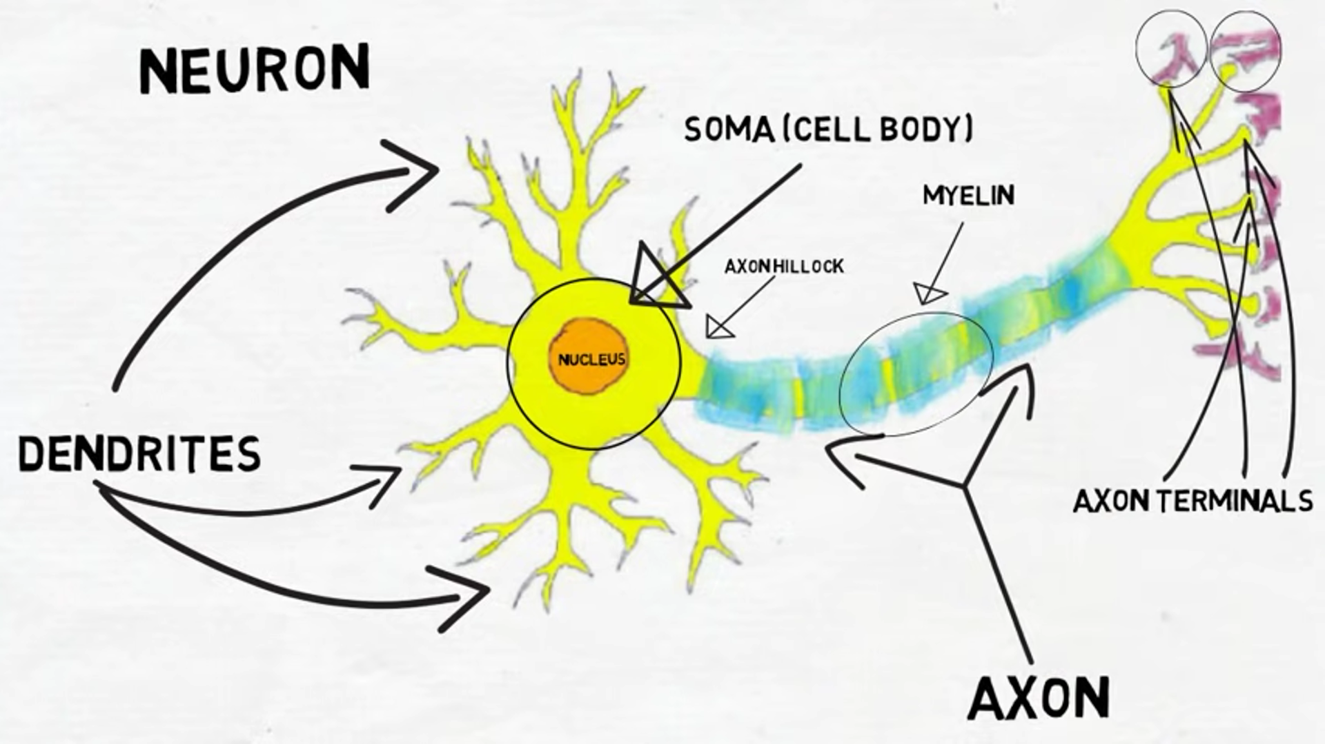

Slide 7
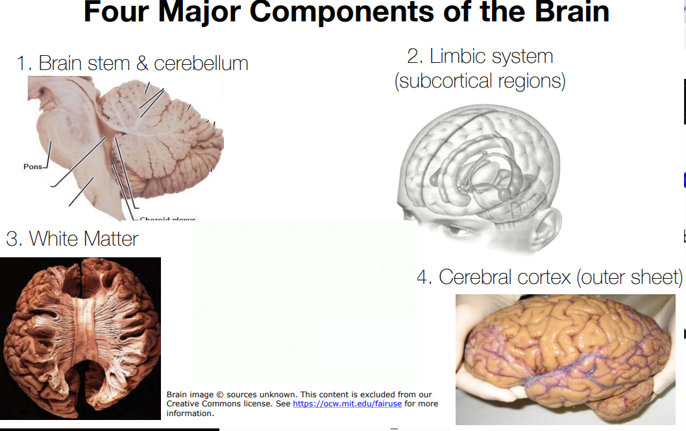
j

Slide 8
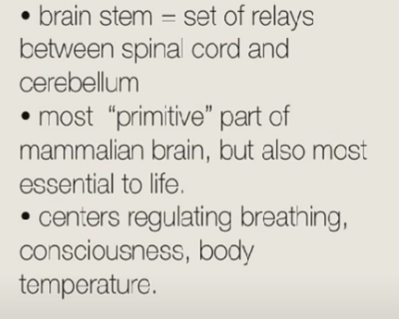
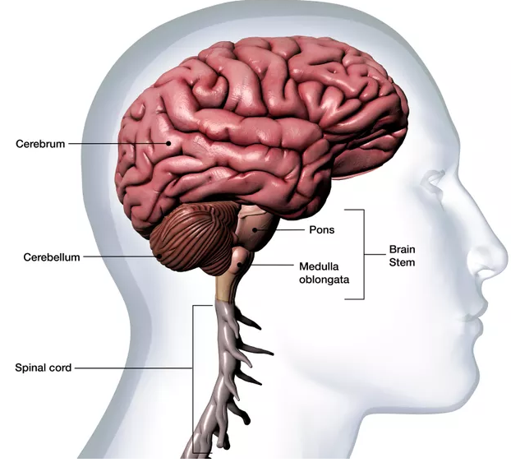
Brain stem & cerebellum
Brain stem relays for the information coming from spinal cord.
And send to Cerebellum.

Slide 9
Brain stem & cerebellum
Cerebellum involves in motor coordination
Role in cognition is unclear

Slide 10
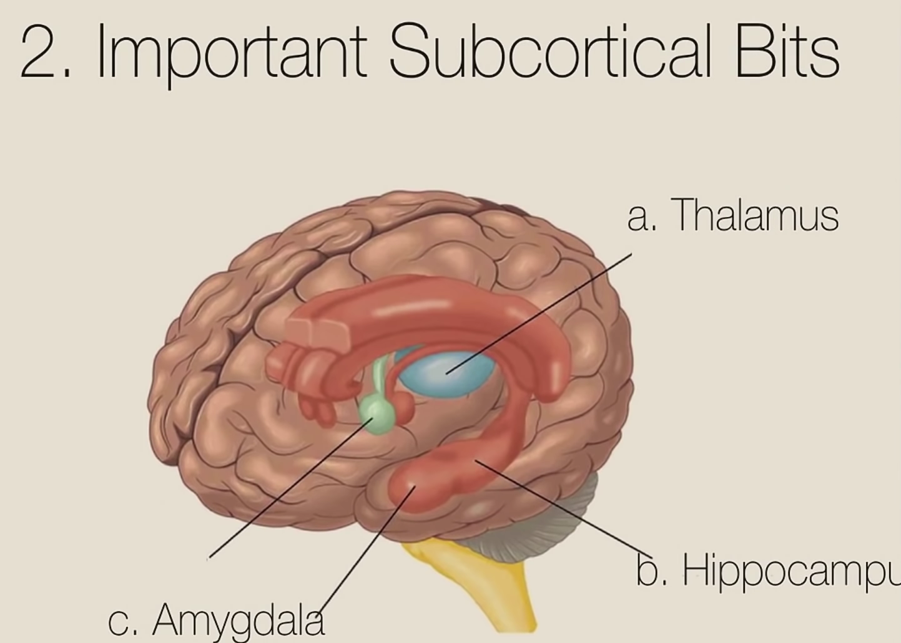

Slide 11
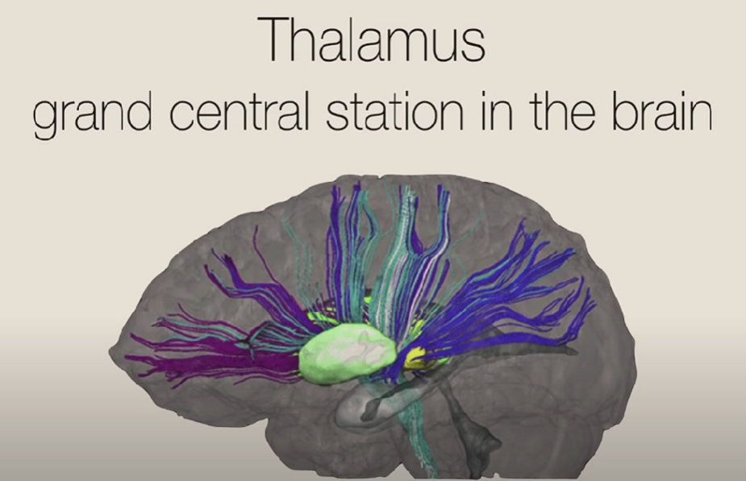

Slide 13
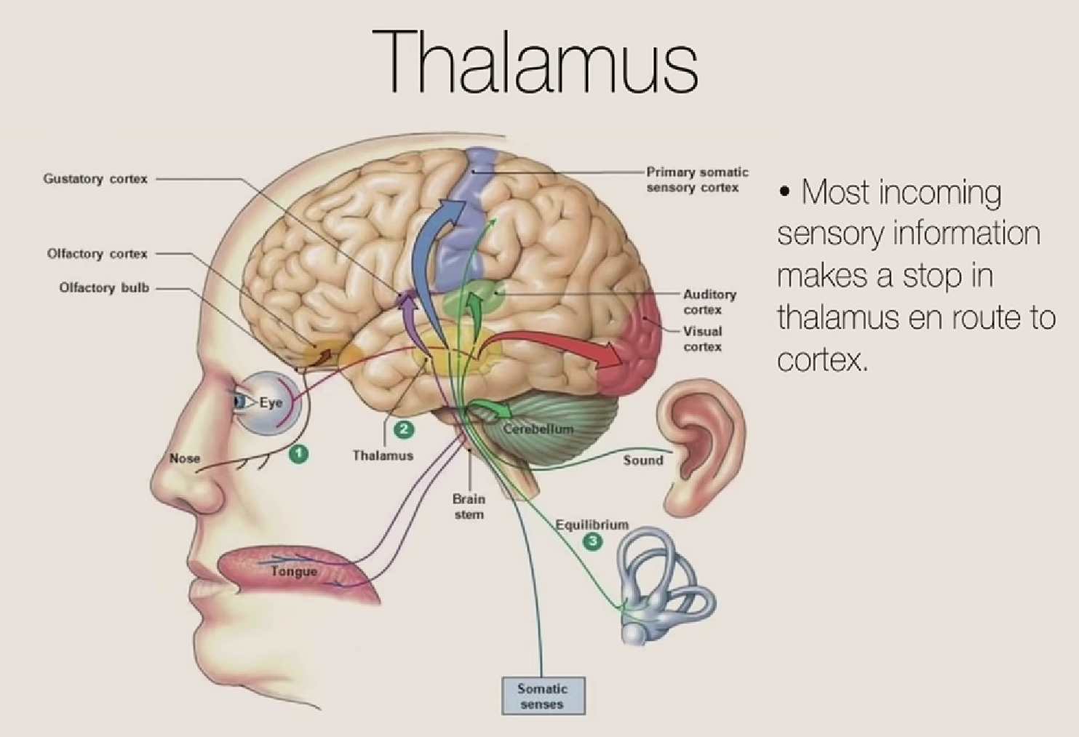

Slide 14
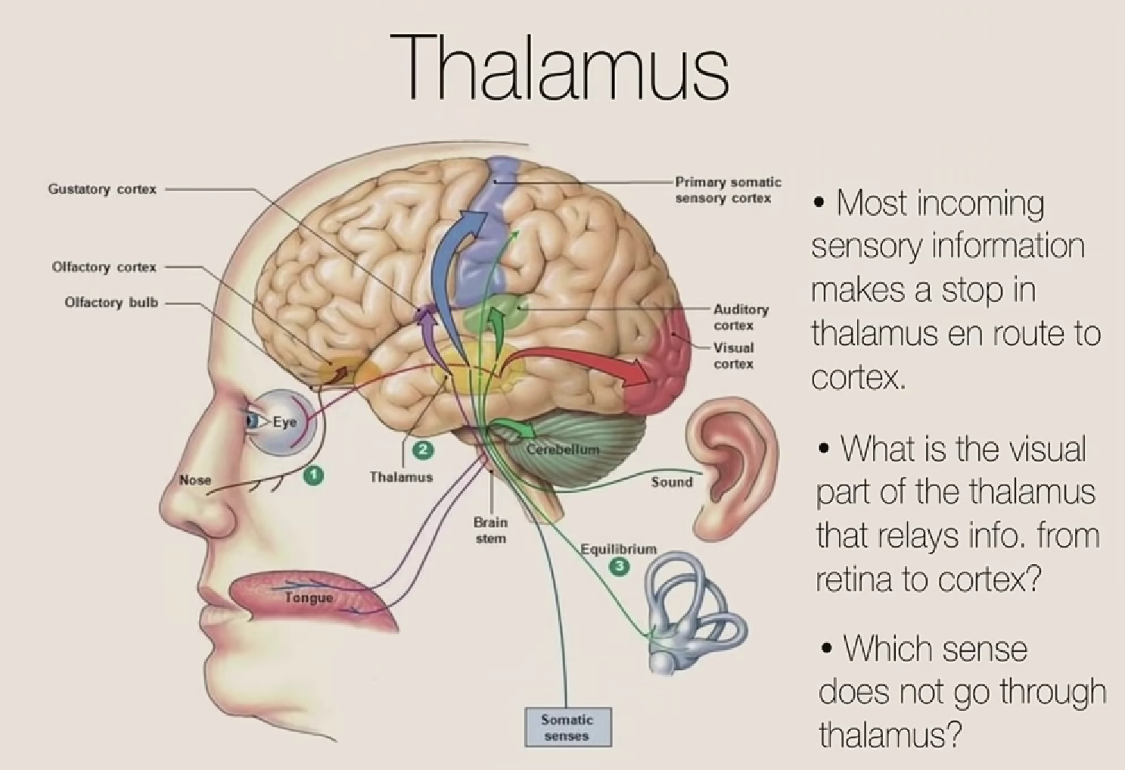

Slide 15
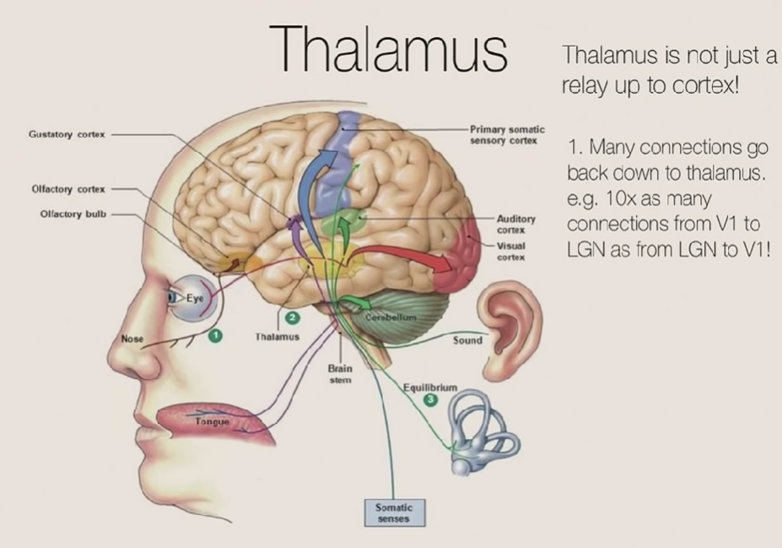

Slide 16
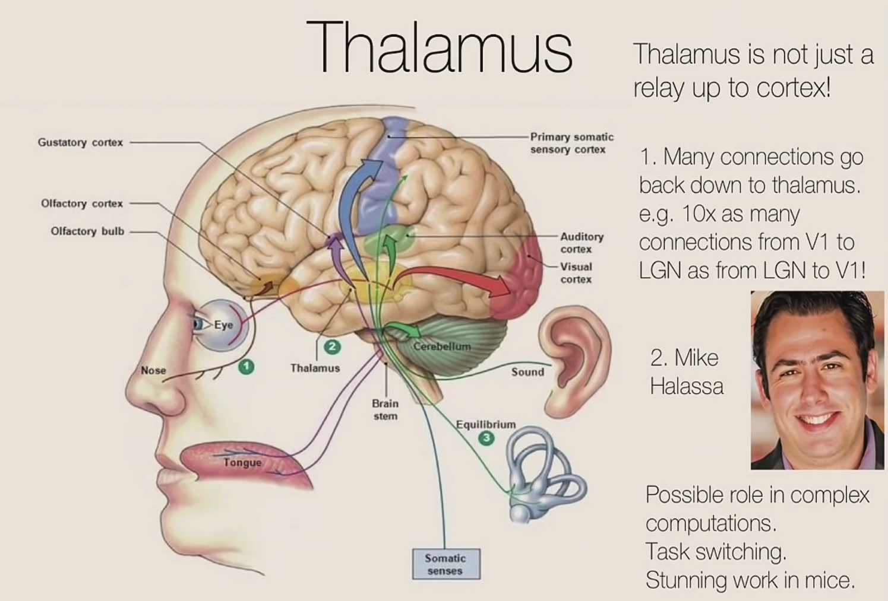
Thalamus involved in high-level cognitive computation in mice.
When mice needs to switch from one task to another, Thalamus plays a key role.

Slide 17
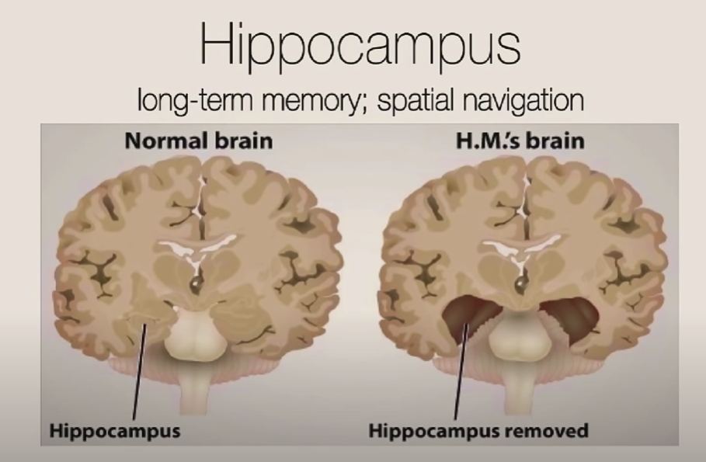

Slide 18
The curious case of HM Brain
Henry Gustav Molaison (February 26, 1926 – December 2, 2008), known widely as H.M., was an American.
Surgically resect his hippocampi in an attempt to cure his epilepsy.
Although the surgery was partially successful in controlling his epilepsy, a severe side effect was that he became unable to form new memories.
Another case of Lonni sue Johnson: Multitalented lady,
Does not remember any events of previous life, after viral infection.

Slide 19
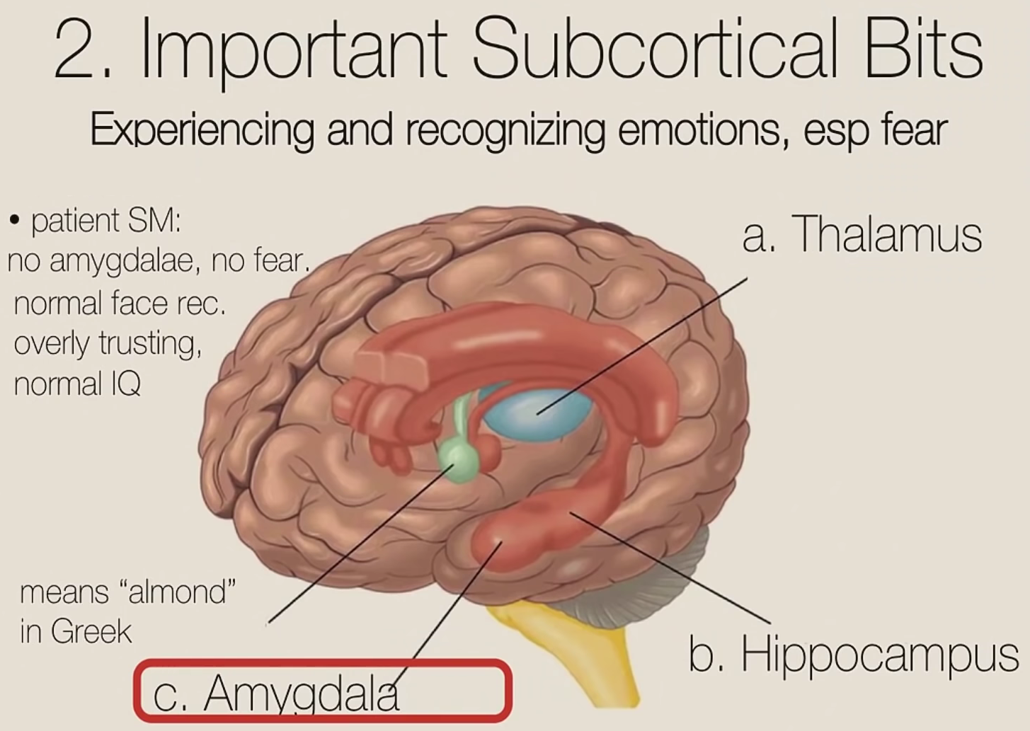
S.M., also sometimes referred to as SM-046, is an American woman with a peculiar type of brain damage that may affect her ability to feel fear.

Slide 21
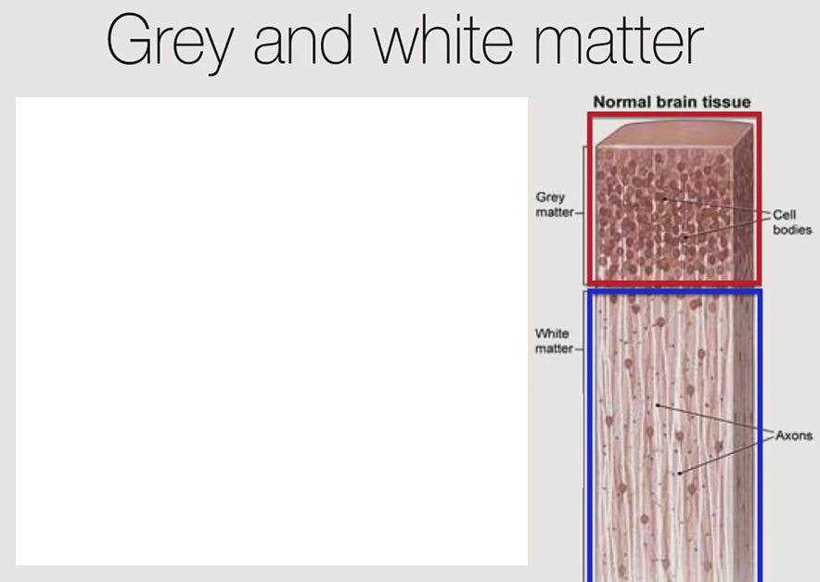

Slide 22
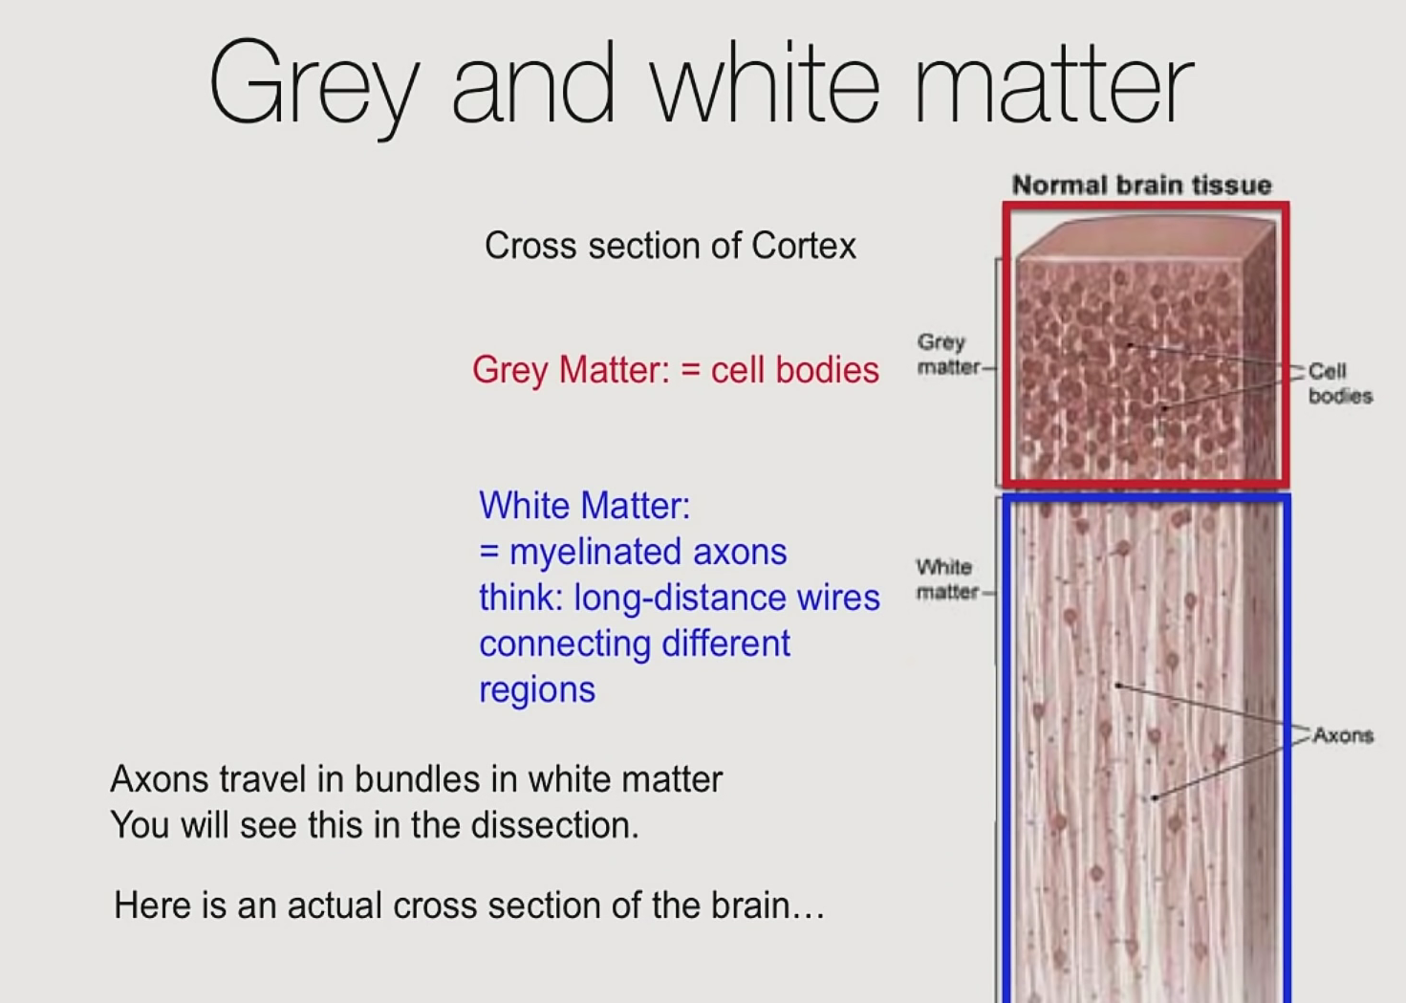

Slide 23
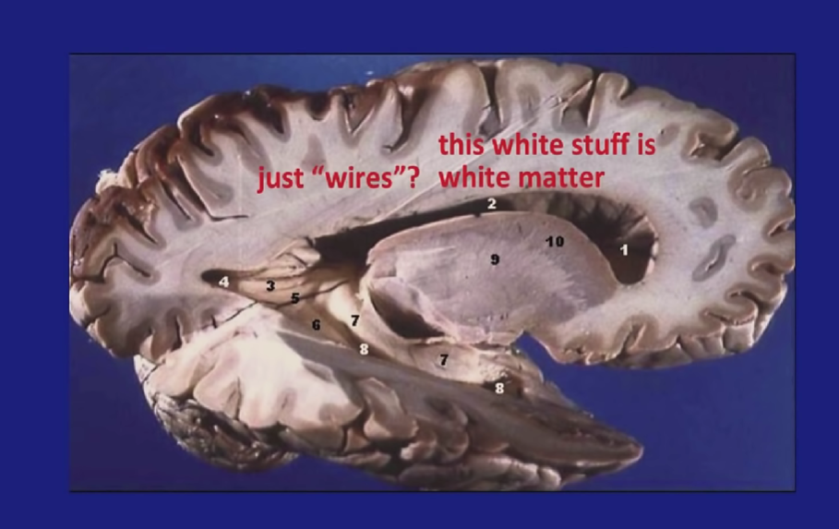
Just bunch of wires, but they are very interesting.

Slide 24
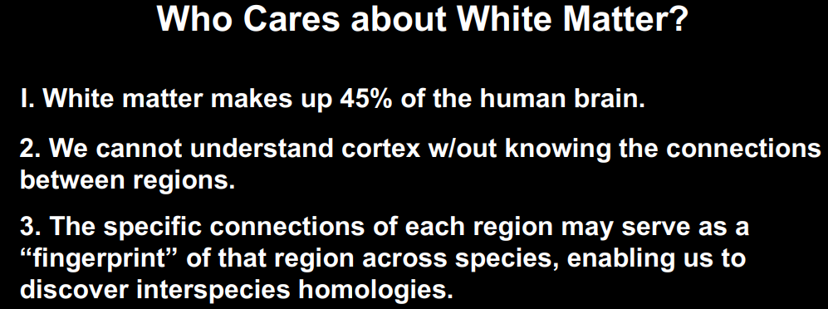

Slide 25
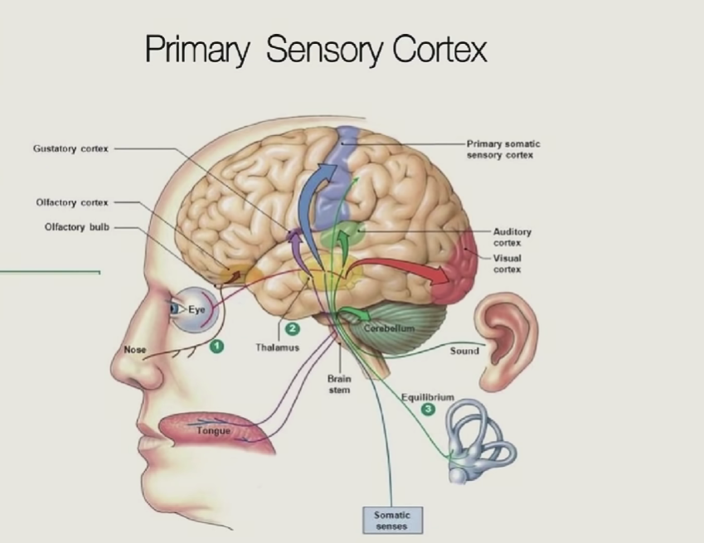
They are primary in the sense, this is the first place there sensory information lands up at the cortex coming from the senses.

Slide 26
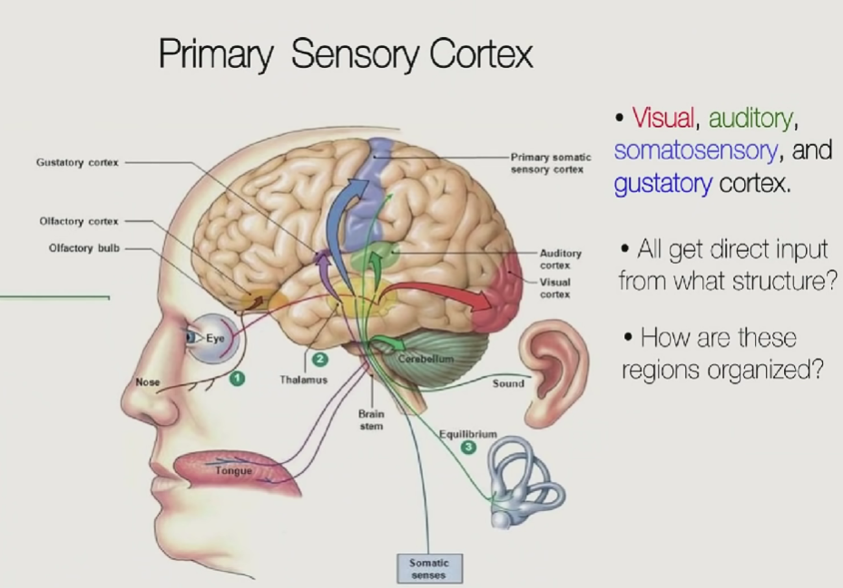

Slide 27
To understand map, first we need to understand Receptive Field.
RF is the property of individual cell in the brain.

Slide 29
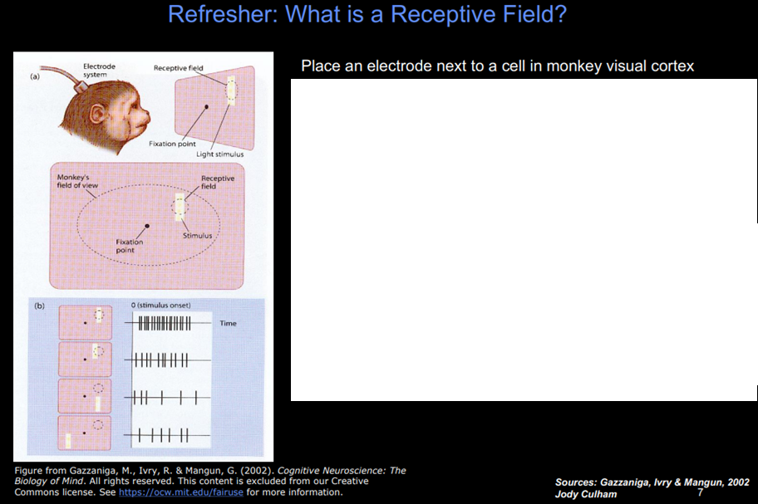

Slide 30
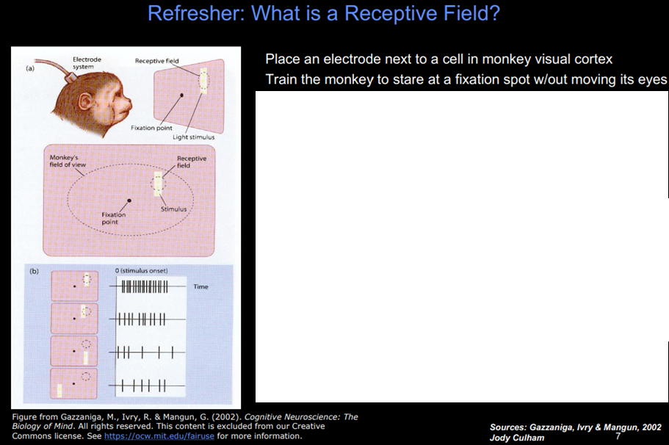
And then while recording neuron,
You put flash different locations.

Slide 31
And then while recording neuron,
You put flash different locations.
RF is the place in the visual world that makes a particular neuron fire.
Responds to a particular flash location not others flashes.

Slide 32
In visual cortex, neurons have restricted RF.
They don’t respond anything and anywhere in the visual field.
They respond to a particular place in the space.

Slide 33
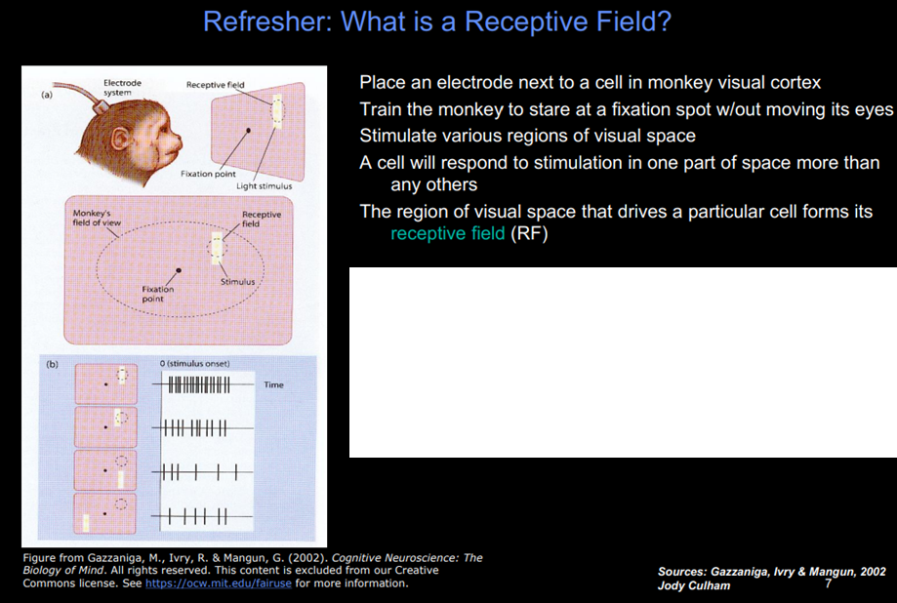

Slide 34
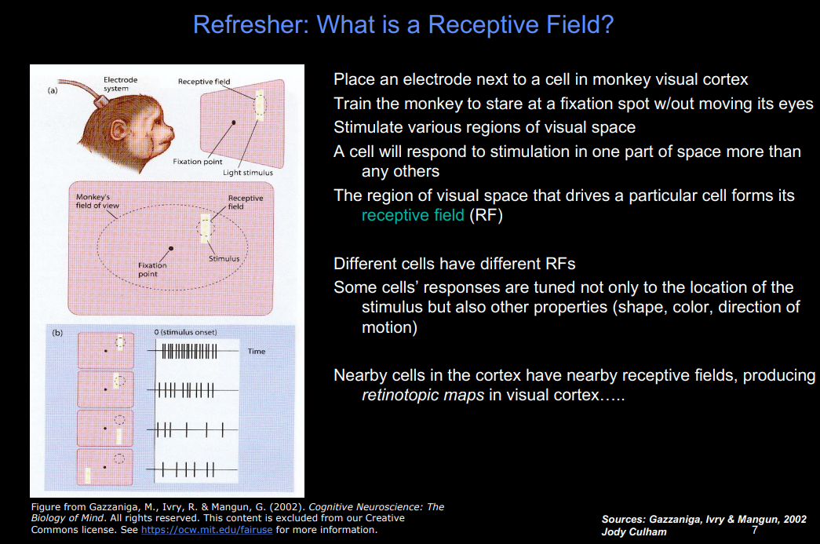

Slide 35

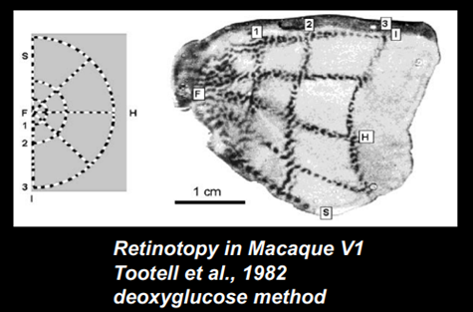
Totell injects radioactive deoxyglucose when monkey looking at one point

Slide 36
Totell injects radioactive deoxyglucose when monkey looking at one point.
Radioactive chemical emits radiation and it is detected by radioactive detector.

Slide 37
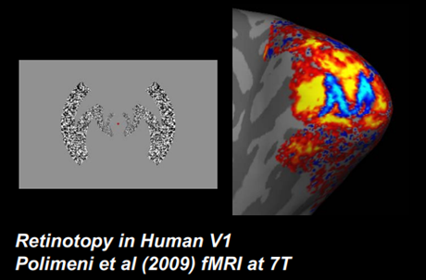

Slide 38
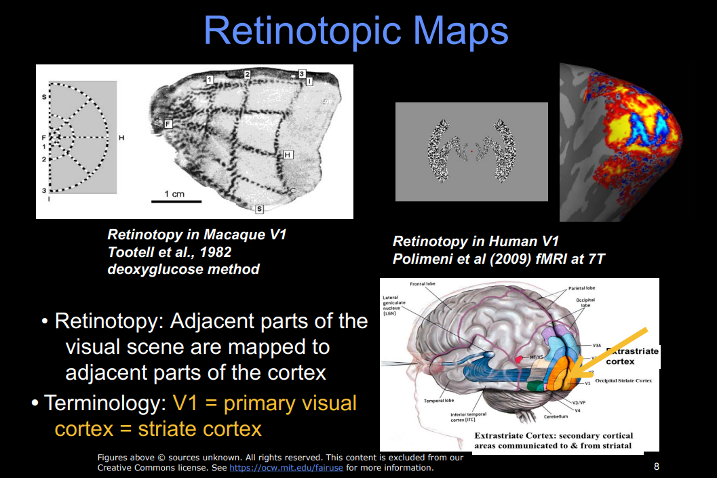

Slide 39
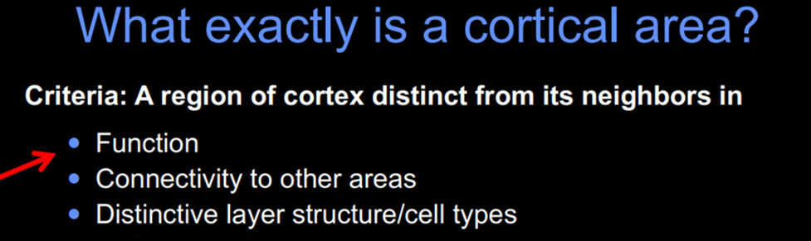
Physically different

Slide 40

Physically different

Slide 41
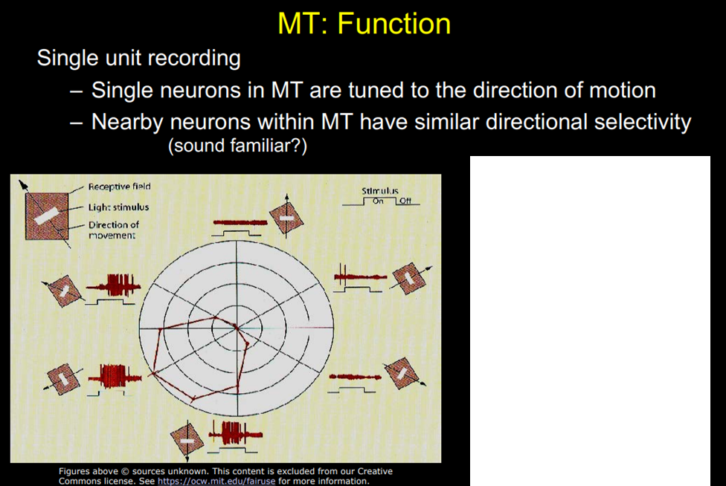

Slide 42
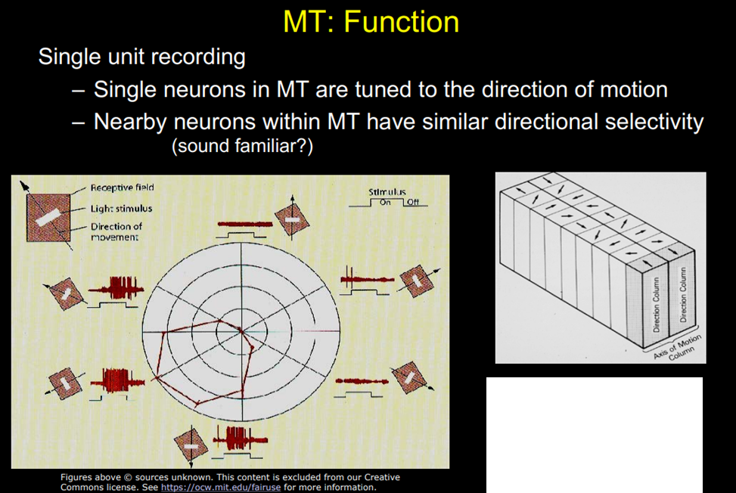
As you move across the cortex, you see a systematic change in the direction selectivity of neurons.

Slide 43
MT (middle temporal)
In MT, we have map of direction preference.
Like we have map of spatial location in V1.

Slide 44
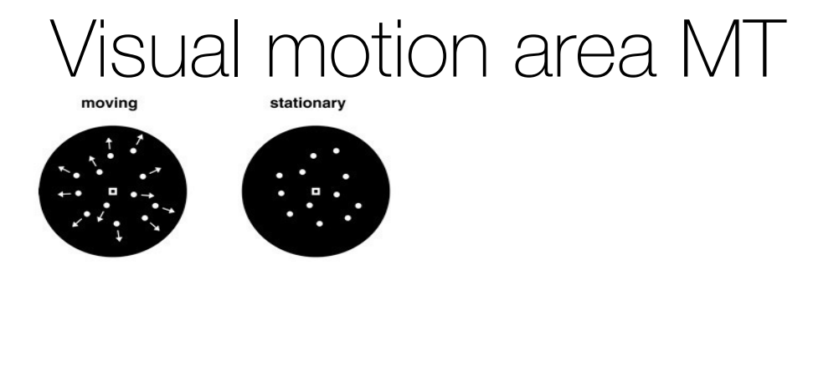

Slide 45
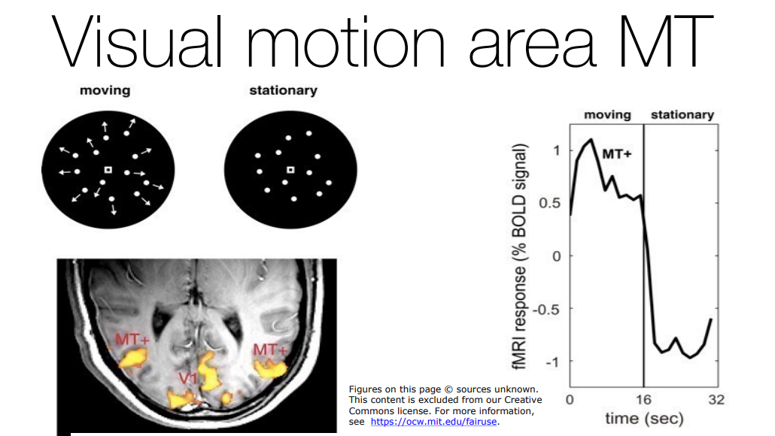
blood-oxygen-level-dependent (BOLD)

Slide 46
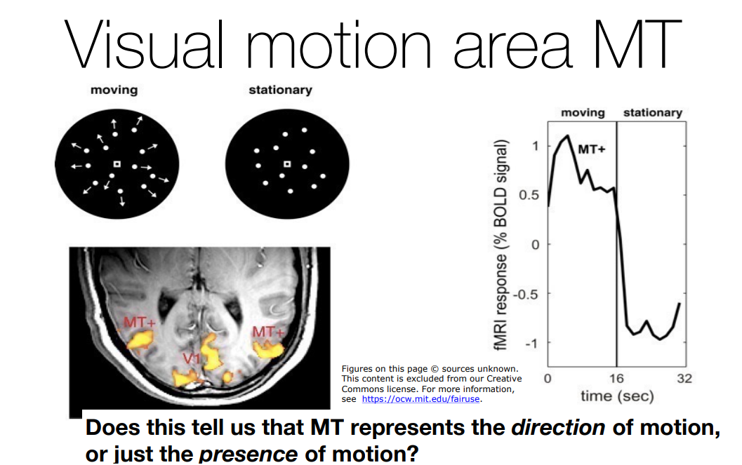

Slide 47
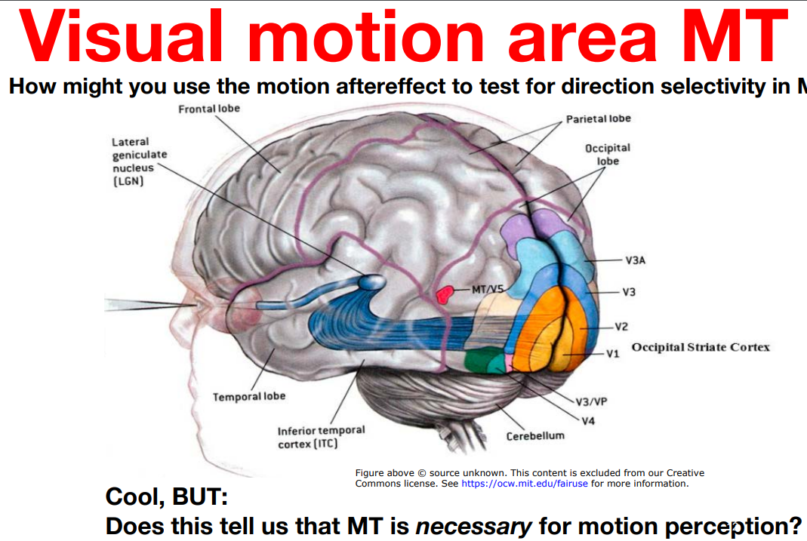

Slide 48

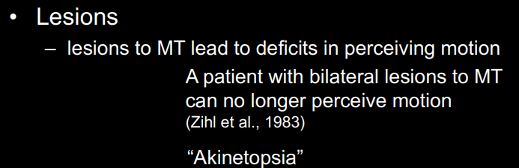


Slide 49
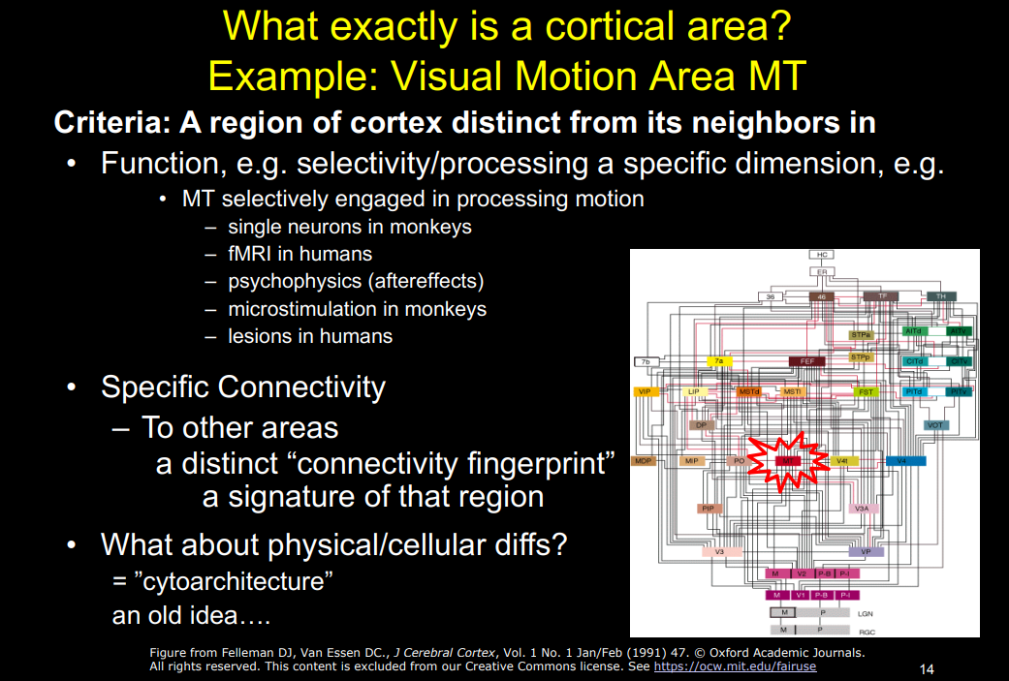
Cytoarchitecture, also known as cytoarchitectonics, is the study of the cellular composition of the central nervous system's tissues under the microscope.

Slide 50
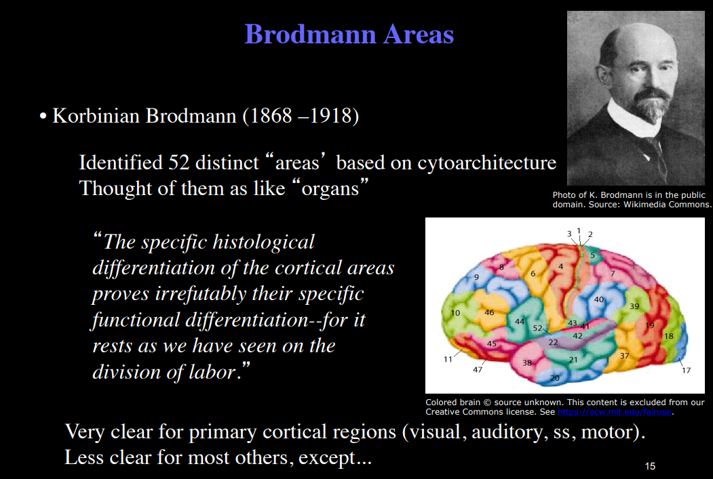

Slide 51
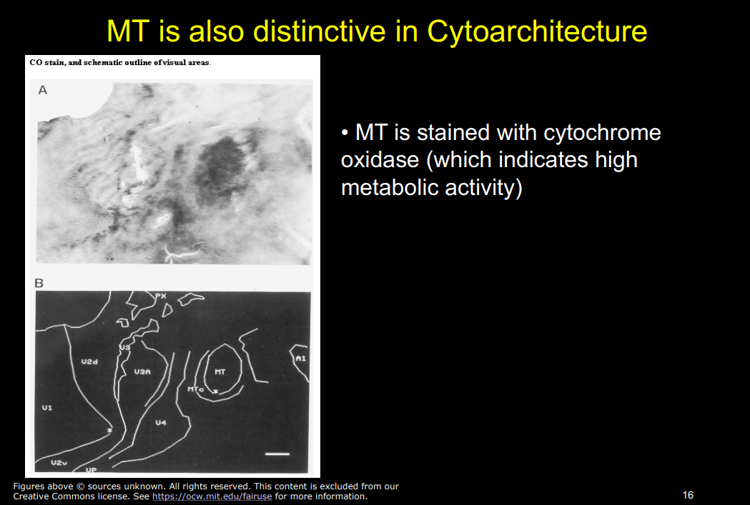

Slide 52
